Slide 1

Business Insights 360
ATLIQ HARDWARE

Slide 2

AGENDA
About the Company
Problem and Goal
Data Modelling
Dashboard
Key Takeaways and Focus Areas

Slide 3

ABOUT
AtliQ Hardware is a leading provider of computer hardware and peripherals, specializing in:
Personal Computers (PC)
Storage Devices
Computer Peripherals
Networking Devices

Slide 4
COMPANY overview

Slide 5
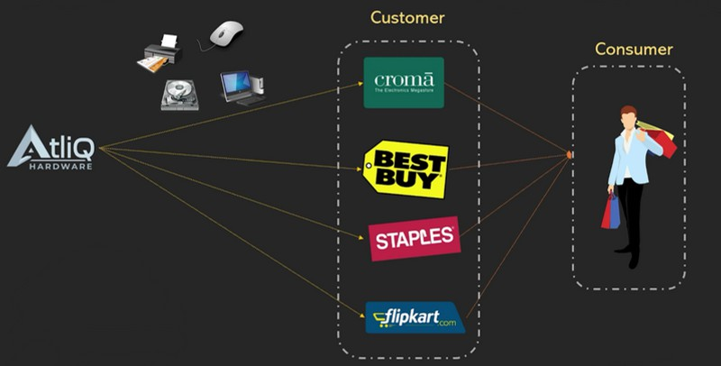


Slide 6
CHANNEL & PLATFORM overview

Slide 7
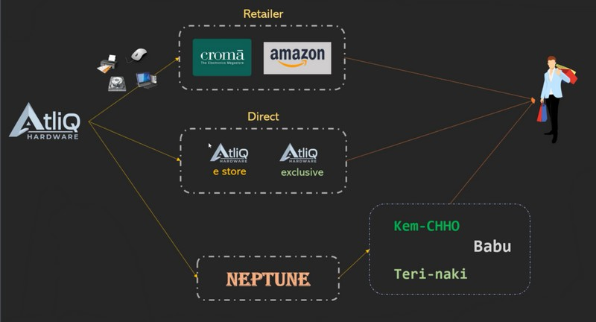


Slide 8

Team role at company
Executive Team
Finance Team
Sales Team
Marketing Team
Supply Chain Management Team

Slide 9
PROBLEM STATEMENT
Limited scalability: Excel could not handle the growing data volume.
Inefficient analysis: Time-consuming and prone to errors.
Financial loss in Latin America: Resulting in Losses in the Latin American Market
Want to make data driven decision.
GOALS
Develop and implement an advanced analytics solution
Enable Efficient Data Analysis and Informed Decision-Making
Handle increasing data volume across regions.
Quickly analyze business performance daily.

Slide 10
TOOLS USED
For Data Visualization : Power BI Software
For Data Collection and Retrieval : MySQL workbench
For Miscellaneous Files import and analysis : Microsoft Excel
For Publishing and Sharing Dashboard : Power BI Service

Slide 11
DATASET AND DATA MODELLING overview

Slide 12
DATASET OVERVIEW :
Fiscal Year :
September – August
Actual Data :
2018, 2019, 2020, 2021, 2022 Est (Till DEC)

Slide 13
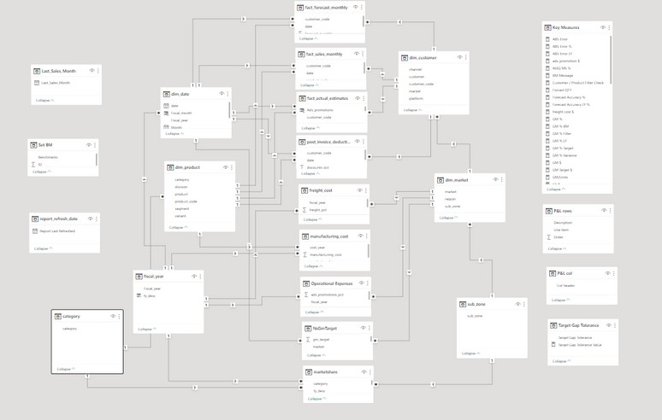


DAX measures allow you to calculate key metrics dynamically in Power BI and other tools so that the results update automatically as you filter, slice, or drill down into your data.
The Snowflake schema reduces data redundancy by normalizing dimension tables into multiple related tables.

Slide 14
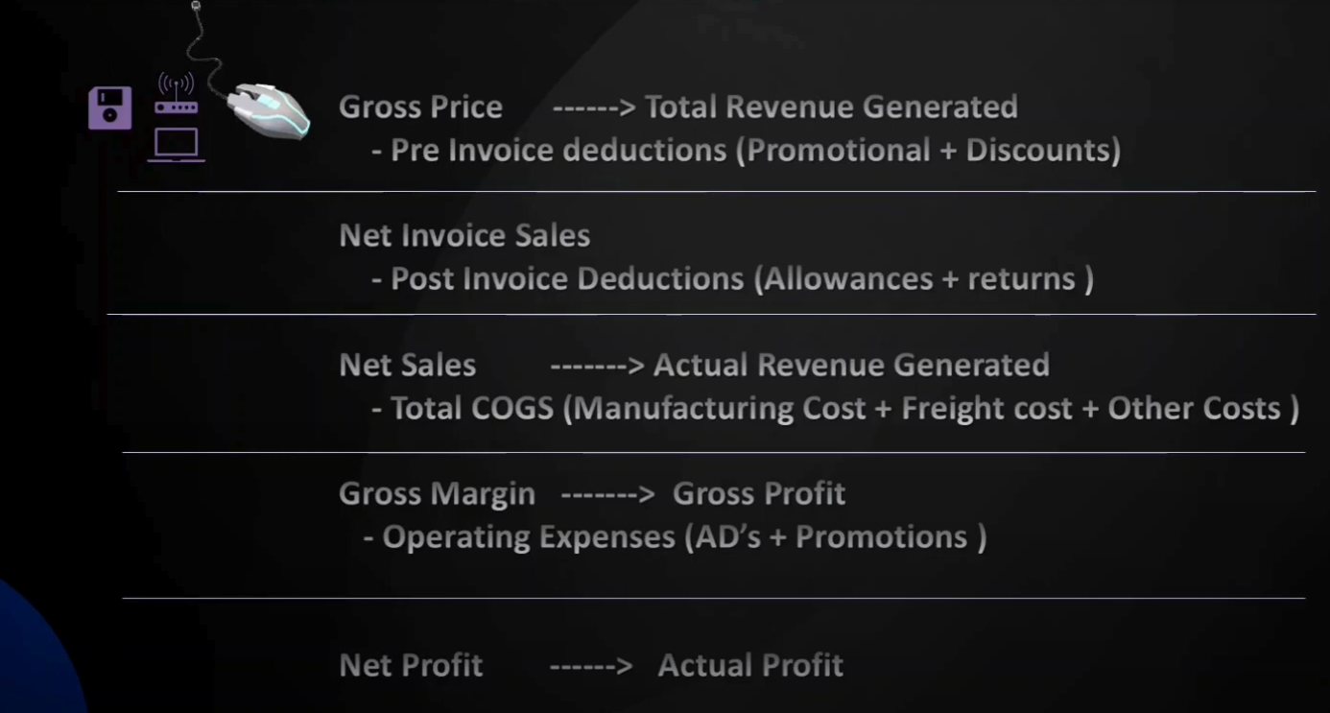
Key variables

Slide 15
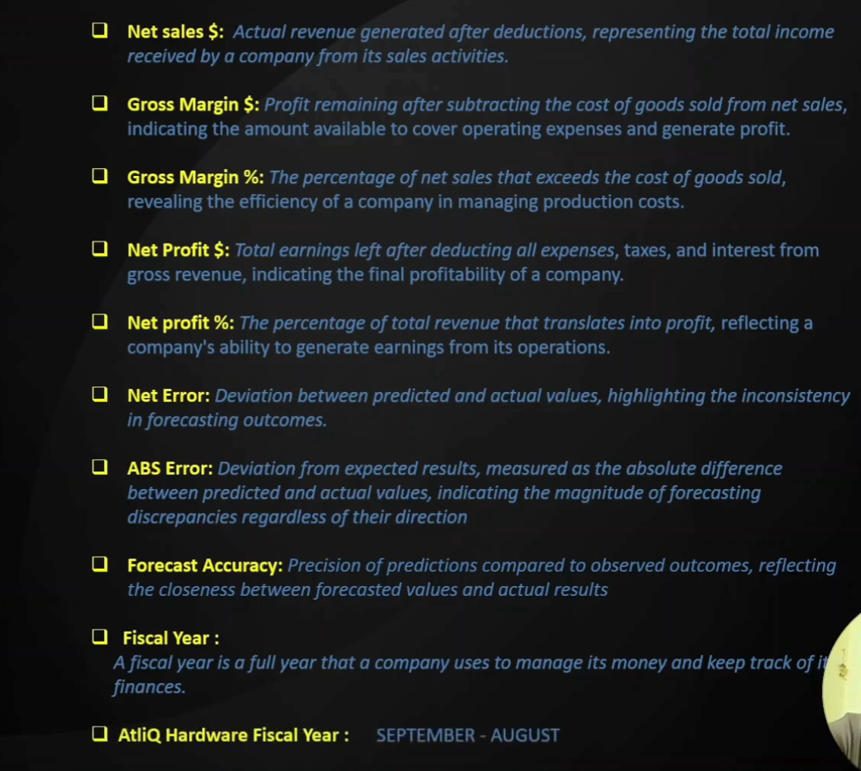
Key variables

Slide 16
DASHBOARD
https://shorturl.at/SRzF1

Slide 17
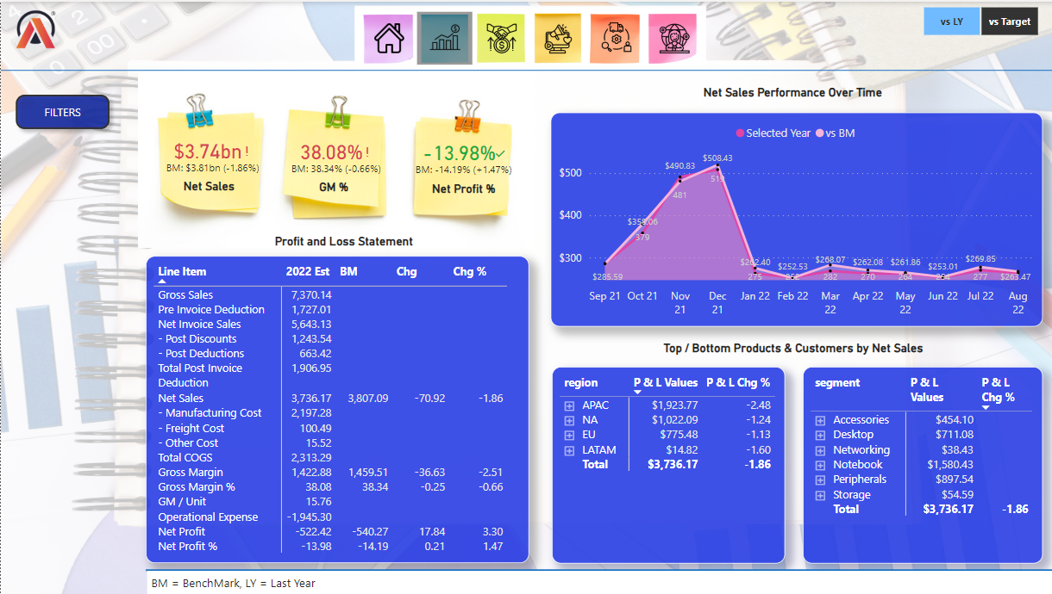
Financial VIEW

Slide 18
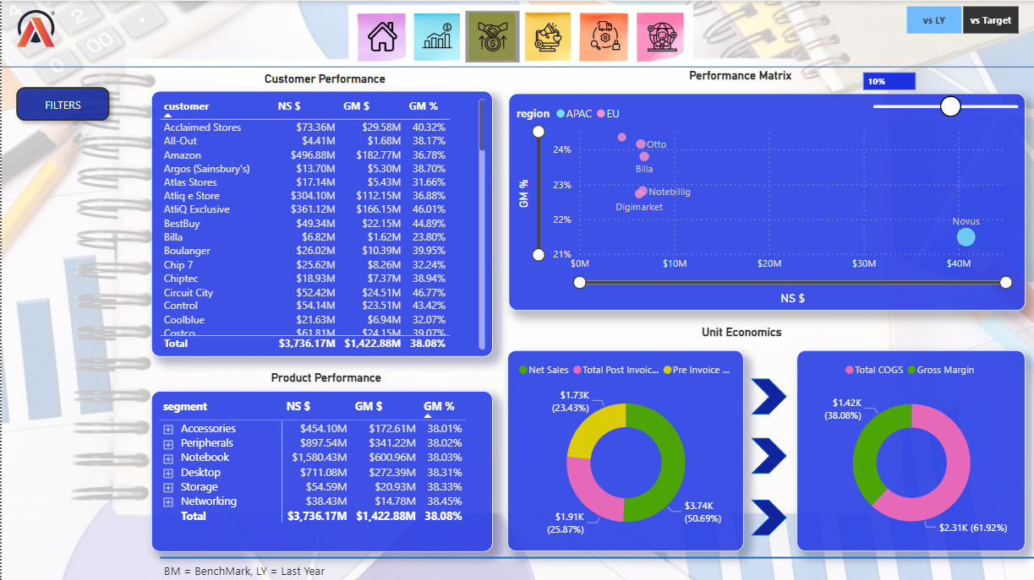
Sales view

Slide 19
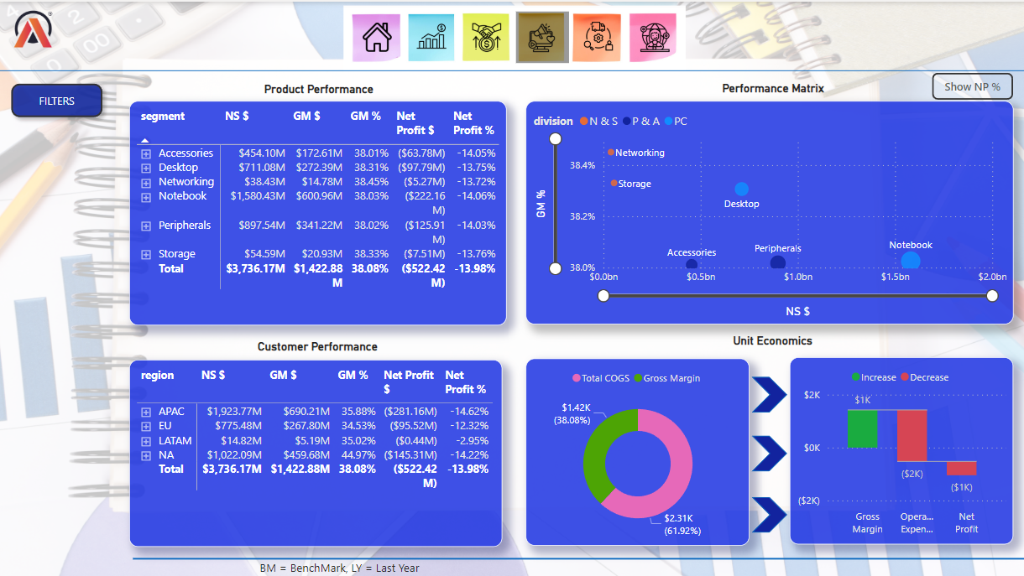
MARKETING VIEW

Slide 20
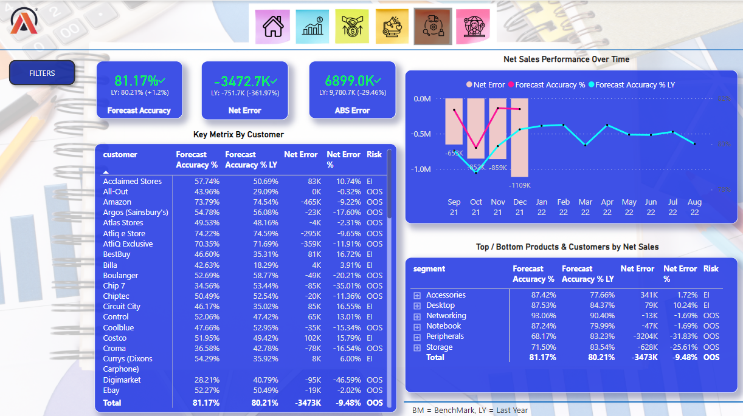
SUPPLY CHAIN VIEW

Slide 21
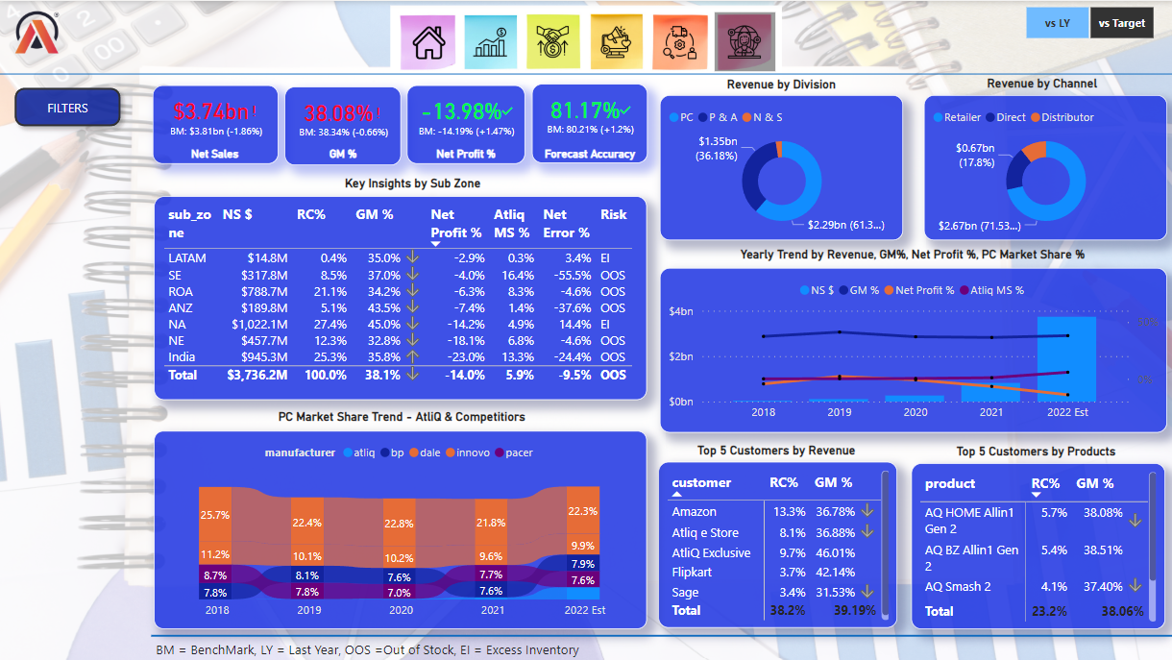
EXECUTIVE VIEW

Slide 22
Key Takeaways and Focus Areas

Slide 23
Key Takeaways
Here are some of the most valuable insights AtliQ gained from their Power BI dashboards:
Top Market:
India leads in Net Sales ($1.27B) and Revenue Contribution (25.59%), but falls short in Gross Margin percentage.
Canada leads in Gross Margin (44.53%).
Top Customer:
Amazon leads in Net Sales ($460.37M) and Revenue Contribution (9.27%).
Relief (operating in Canada & Spain) leads in Gross Margin (45.4%).
Top Product:
AQ Home All-in-1 Gen2 leads in Net Sales ($218.5M) and Revenue Contribution (4.4%).
AQ LION X1 has the best Gross Margin (38.4%).
Forecast Accuracy:
Improving yearly, showcasing better inventory and sales predictions.

Slide 24
Key Takeaways
Atliq Hardware is offering significant discounts to customers.
Amazon is the highest revenue generator for Atliq Hardware in terms of customers.
AQ Home Al 1 Generation 2 is the top-performing product for Atliq Hardware.
Atliq Hardware is performing poorly in the USA, None of the products are currently profitable in the US market.
Atliq Hardware's market share was only 1.1% in 2021 but grew significantly to 5.9% in 2022.

Slide 25
FOCUS AREAS
Based on the insights from Power BI, AtliQ’s executive team can take several critical actions:
Control COGS and Operational Expenses:
Reducing these will help improve profit margins, especially in markets like India and LATAM.
Focus on high-performing segments:
For instance, the PC segment has the highest Revenue Contribution (54.98%), suggesting an opportunity for further growth in this area.
Leverage successful products and customers:
Focusing on top-performing products like AQ Home All-in-1 Gen2 and AQ LION X1, as well as top customers like Amazon, can drive additional growth.

Slide 26
THANK YOU
Power BI Live Dashboard: https://shorturl.at/SRzF1 Full Project Presentation: https://www.youtube.com/watch?v=G7lz2goFStQ

